Slide 1
Bit Manipulation
What is a Bit?
Bit stands for “Binary Digit”. A bit can take only two values 0 and 1. Machine represents numbers in binary form. It is easy to represent binary digits with voltage levels.
High Voltage 1
Low Voltage 0
Bit operations are faster and optimized
Operations with bits are used in data compression, XOR Encryption.

Slide 2
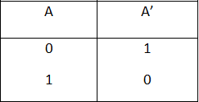
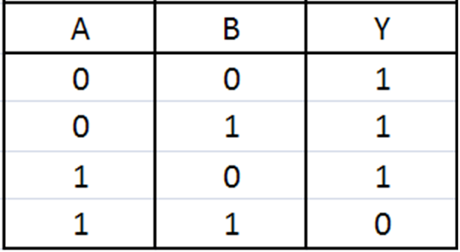
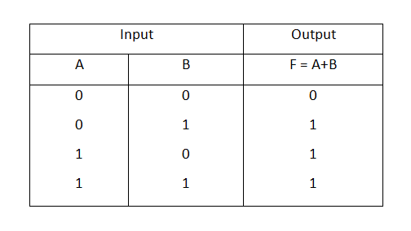
Basic Operations:
NOT
~(0111011) = 1000100
2. AND
1011010
&
0110111
0010010
3. OR
1001010
|
0101010
1101010

Slide 3
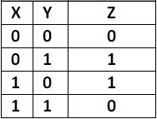
4. XOR
1011010
^
0110111
1101101
5. Left Shift
1011010 << 2 = 1101000
6. Right Shift
1011010 >> 2 = 0010110

Slide 4
N-1 representation in binary
Binary representation of (x-1) can be obtained by simply flipping all the bits to the right of rightmost 1 in x and also including the rightmost 1.
Let x = 4 = (100)₂ x - 1 = 3 = (011)₂
Let x = 6 = (110)₂ x - 1 = 5 = (101)₂

Slide 5
Number of set bits
The basic approach to evaluate the binary form of a number is to traverse on it and count the number of ones. But this approach takes log₂N of time in every case.
Why log₂N ? As to get a number in its binary form, we have to divide it by 2, until it gets 0, which will take log₂N of time.
int count_one (int n)
{
while( n )
{
n = n&(n-1);
count++;
}
return count;
}

Slide 6
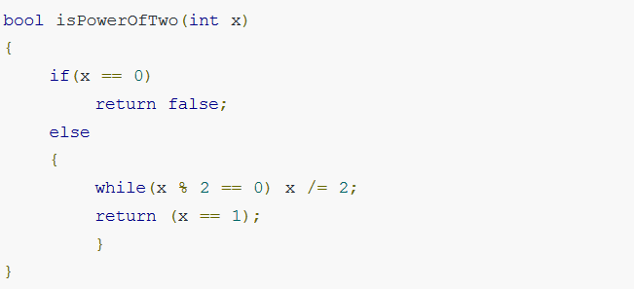
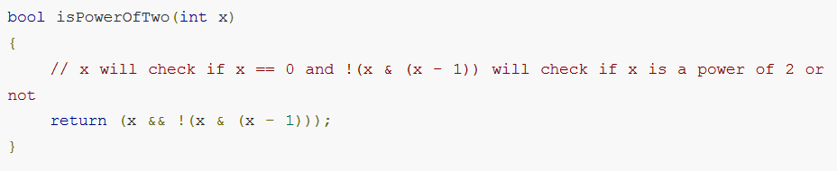
Check if given number is power of 2
Basic Approach:
Efficient Approach:

Slide 7
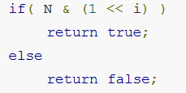
Check if the i^{th} bit is set in the binary form of the given number
Set the i^{th} bit in a number
x | (1 << i)
(1 << i) will return a number with only i^{th} bit set. So if we OR it with x it will set the i^{th} bit of x.

Slide 8
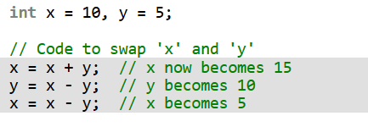
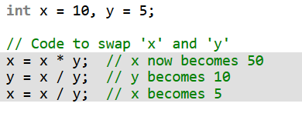
Swap two numbers
Method 1 (Using Arithmetic Operators)

Slide 9

Swap two numbers
Method 1 (Using Arithmetic Operators)
Method 2 (Using Bitwise XOR) Efficient Approach

Slide 10
Find the one missing number in range
12 11 10 13 15

Slide 11
Find the one missing number in range
12 11 10 13 15
Find min and max number and XOR of all numbers
Min = 10
Max = 15
XOR = 12 ^ 11 ^ 10 ^ 13 ^ 15
Traverse from min to max number and take XOR
(12 ^ 11 ^ 10 ^ 13 ^ 15) ^ (10 ^ 11 ^ 12 ^ 13 ^ 14 ^ 15)
= 14

